Slide 1
Course Overview
Introduction to Algorithms
Sorting Algorithms P2
Module 1
Module 4
Graph Algorithms P2
Searching Algorithms P1
Module 8
Basic Data Structures
Module 5
Module 2
String Processing
Searching Algorithms P2
Module 6
Module 9
Sorting Algorithms P1
Other Topics
Module 3
Module 7
Graph Algorithms P1
Module 10

Slide 2
Module 1: Introduction
Note: Some of these slides have been adapted from
slides freely available on the Internet and also from the
slides accompanying the course textbook.

Slide 3
Learning Outcomes
By the end of this lecture, students will:
Understand algorithms and their key properties.
Analyze algorithm efficiency using Big-O notation.
Understand recursion.
Notes:
By the end of today’s lecture, you should:
Understand algorithms and their importance.
Analyze efficiency using Big-O notation.
Apply recursion effectively in problem-solving.

Slide 4
Topics
What is an algorithm
Algorithmic Problem Solving
Big-O
Recursion
Outcome 1
Outcome 2
Outcome 3

Slide 5
What is an algorithm?
An algorithm is a sequence of unambiguous instructions for solving a problem, i.e., for obtaining a required output for any legitimate input in a finite amount of time.
problem
algorithm
“computer”
input
output
Topic: What is an algorithm
Notes:
An algorithm is a step-by-step procedure for solving a problem. It takes an input, processes it, and produces an output in a finite number of steps.
Examples:
A recipe is an algorithm for cooking.
Google Search uses algorithms to rank web pages.
Sorting a contact list is done using an algorithm.

Slide 6
What is an algorithm?
Can be a recipe, process, method, technique, procedure, routine,… with following requirements:
Finiteness
terminates after a finite number of steps
Definiteness
rigorously and unambiguously specified
Input
valid inputs are clearly specified
Output
can be proved to produce the correct output given a valid input
Effectiveness
steps are sufficiently simple and basic
Topic: What is an algorithm
Notes:
A well-defined algorithm must: ✅ Be finite – It must terminate after a set number of steps. ✅ Be unambiguous – Each step must be precisely defined. ✅ Have valid input & output – It must accept inputs and return the correct output. ✅ Be efficient – It should use minimal time and memory.

Slide 7
Why study algorithms?
Theoretical importance
the core of computer science
Practical importance
A practitioner’s toolkit of known algorithms
Framework for designing and analyzing algorithms for new problems
Topic: What is an algorithm
Notes:
Theoretical importance – Algorithms form the foundation of computer science.
Practical importance – They improve performance in real-world applications.
Essential for interviews – Algorithm problems are common in coding tests and job interviews.

Slide 8
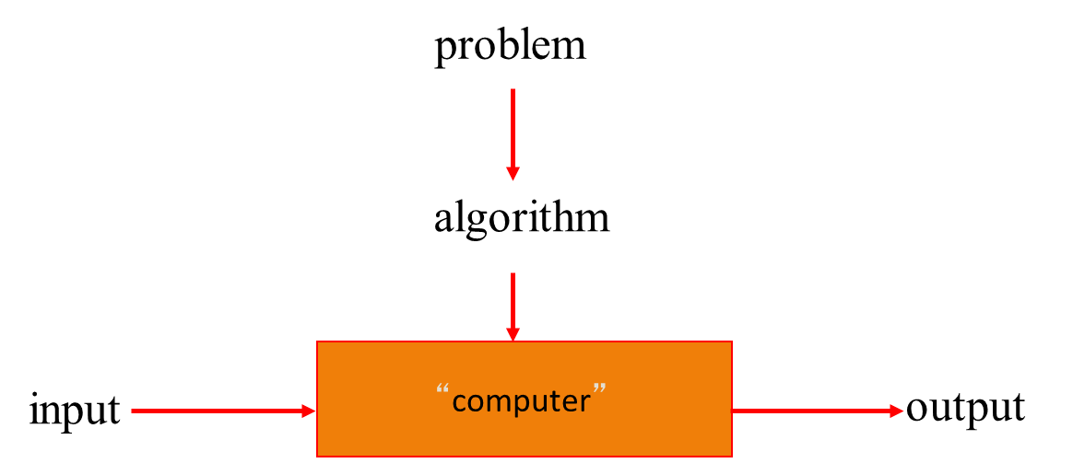
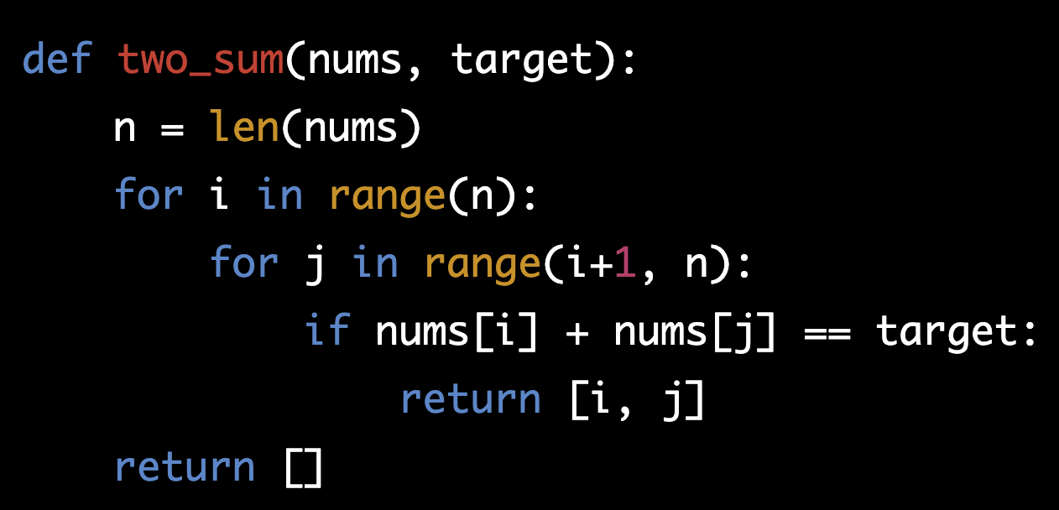
Algorithm example
Problem:
Given an array of integers nums and an integer target, return indices of the two numbers such that they add up to target.
You may assume that each input would have exactly one solution, and you may not use the same element twice.
You can return the answer in any order.
Input: nums = [2,7,11,15], target = 9
Output: [0,1]
Output: Because nums[0] + nums[1] == 9, we return [0, 1].
Notes:
Problem: Given an array of numbers, find two that sum to a given target.
Example:
Input: nums = [2,7,11,15], target = 9
Output: [0,1] (since nums[0] + nums[1] == 9)
There are different ways to solve this—some fast, some slow. Choosing the right approach is what algorithm design is all about.

Slide 9
Basic Issues Related to Algorithms
How to design algorithms
How to express algorithms
Proving correctness
Efficiency
Theoretical analysis
Empirical analysis
Optimality
Topic: Algorithmic problem solving
Notes:
When working with algorithms, there are key issues to consider to ensure they are effective, correct, and efficient.
How to design algorithms: The first step is choosing the right approach to solve a problem.
How to express algorithms
Algorithms can be represented using:
Pseudocode – High-level step-by-step instructions.
Flowcharts – Visual representation of decision-making steps.
Programming languages – Implementing algorithms in code (Python, Java, etc.).
Proving correctness
An algorithm must always produce the correct output for every valid input.
Proof techniques include:
Induction – Showing correctness step by step.
Contradiction – Assuming the opposite and proving it false.
Efficiency
Theoretical analysis: Uses Big-O notation (study later) to estimate performance based on input size.
Empirical analysis: Running the algorithm with different inputs to measure actual runtime.
Optimality: The best algorithm for a problem is not just correct but also optimal—it should run in the least possible time and use minimal resources.

Slide 10
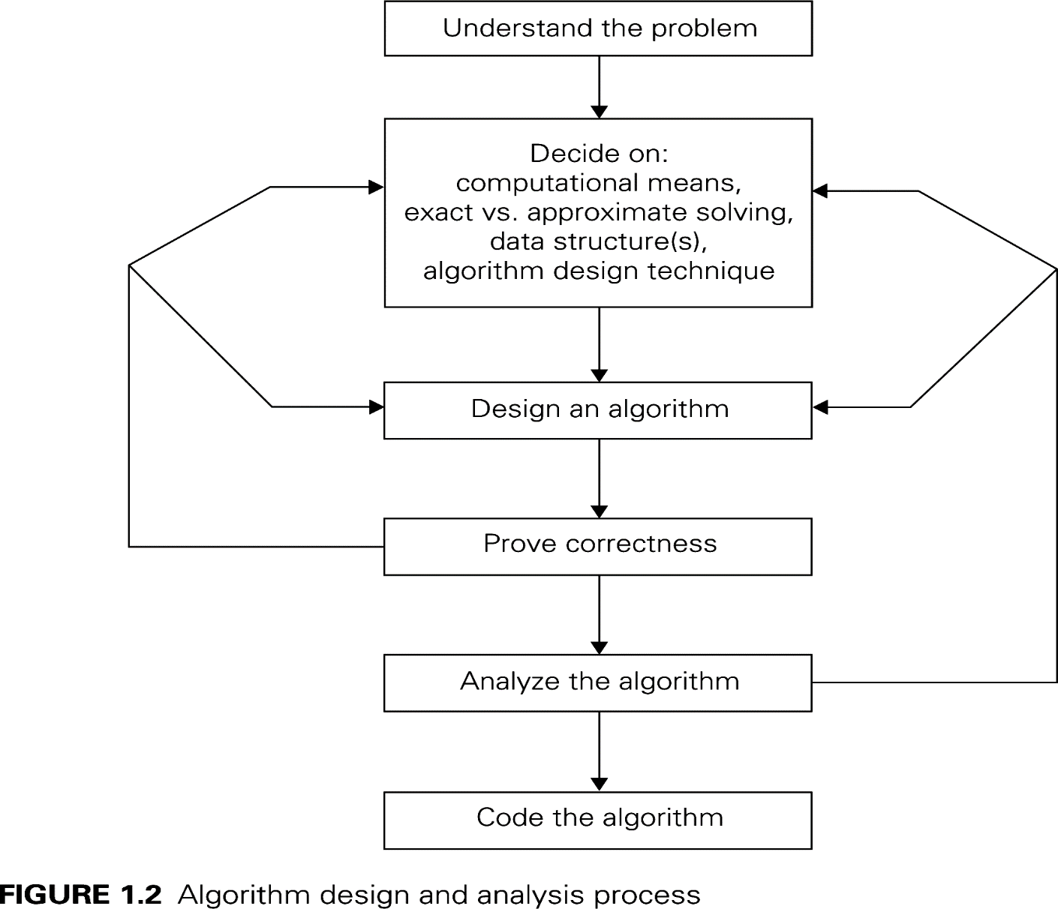
Algorithmic Design and Analysis Process
Topic: Algorithmic problem solving
Notes:
Designing an efficient algorithm requires a structured approach. This process ensures that the algorithm is correct, efficient, and practical.
Steps in the Algorithm Design and Analysis Process
Understand the Problem
Clearly define input, output, constraints, and requirements.
Identify edge cases that might break the solution.
Decide on Computational Means
Exact vs. Approximate Solutions:
Some problems require a precise solution (e.g., sorting).
Others can use an approximate approach (e.g., AI and machine learning).
Data Structures: Choose the best list, stack, queue, tree, or graph.
Algorithm Design Techniques: Decide whether to use Brute Force, Divide & Conquer, Greedy, or Dynamic Programming.
Design the Algorithm
Develop a step-by-step approach to solve the problem.
Consider efficiency and scalability.
Prove Correctness
Ensure the algorithm works for all cases, including edge cases.
Use mathematical proofs, induction, or testing to verify correctness.
Analyze the Algorithm
Measure time complexity (Big-O notation) to evaluate performance.
Measure space complexity to ensure memory efficiency.
Code the Algorithm
Implement in a programming language (Python, C++, Java).
Optimize loops, recursion, and memory usage.
Test with small and large inputs to verify performance.

Slide 11
Algorithm design strategies/techniques
Brute force
Divide and conquer
Decrease and conquer
Transform and conquer
Space and time tradeoffs
Greedy Approach
Dynamic Programming
Iterative improvement
Backtracking
Branch and bound
Topic: Algorithmic problem solving
Notes:
Different problems require different algorithm design techniques to find efficient solutions. Here are some key strategies:
Brute Force → Try all possible solutions (simple but inefficient).
Divide and Conquer → Split the problem into smaller subproblems, solve them, and combine results (e.g., Merge Sort).
Decrease and Conquer → Solve a smaller version of the problem and extend the solution (e.g., Binary Search).
Transform and Conquer → Change the problem into an easier form before solving it.
Space and Time Tradeoffs → Use extra memory to speed up computation (e.g., caching in Dynamic Programming).
Greedy Approach → Make the best local choice at each step, hoping for an optimal solution (e.g., Dijkstra’s Algorithm).
Dynamic Programming → Break the problem into overlapping subproblems and store solutions to avoid recomputation (e.g., Fibonacci Sequence).
Iterative Improvement → Keep refining the solution incrementally.
Backtracking → Explore possible solutions recursively and discard invalid ones (e.g., solving a maze).
Branch and Bound → Used in optimization problems to systematically eliminate non-promising solutions.

Slide 12
Analysis of Algorithms
How good is the algorithm?
Correctness
Time efficiency
Space efficiency
Notes:
To evaluate how good an algorithm is, we analyze it based on three key factors:
Correctness
Does the algorithm always produce the right result for all valid inputs?
Proof techniques like induction, contradiction, and test cases help verify correctness.
Time Efficiency
How fast does the algorithm run as input size grows?
Space Efficiency
How much extra memory does the algorithm use?
Some algorithms trade time for space (e.g., dynamic programming uses extra memory but speeds up execution).
A good algorithm balances correctness, time efficiency, and space efficiency based on the problem’s constraints.

Slide 13
Analysis of algorithm Efficiency
Note: Some of these slides have been adapted from
slides freely available on the Internet and also from the
slides accompanying the course textbook.

Slide 14
Analysis of algorithm Efficiency
Running time and theoretical analysis
Big-O, Big-Ω and Big-Θ notation

Slide 15
How fast is an algorithm?
What does it mean for an algorithm to be fast?
Low memory usage?
Small amount of time measured on a stopwatch?
We’ll revisit this question after developing the fundamentals of algorithm analysis
Space Efficiency?
Time Efficiency?
Topic: Running time and theoretical analysis
Notes:
The speed of an algorithm isn’t just about execution time—it also depends on memory usage and how well it scales with larger inputs.
Time Efficiency
Measures how quickly an algorithm completes based on input size.
Faster runtime is crucial for handling large datasets.
Space Efficiency
Measures how much extra memory an algorithm needs.
Some algorithms use additional memory (recursion, dynamic programming).
Both time and space efficiency must be considered when choosing the right algorithm. This question will make more sense as we explore Big-O notation and algorithm analysis.

Slide 16
Running Time
The running time of an algorithm varies with the input and typically grows with the input size
Average case difficult to determine
In most of computer science we focus on the worst case running time
Easier to analyze
Crucial to many applications: what would happen if an autopilot algorithm ran drastically slower for some unforeseen, untested inputs?
Topic: Running time and theoretical analysis
Notes:
The running time of an algorithm depends on the input size and can vary based on different scenarios.
Why does running time matter?
As input size increases, execution time usually increases.
Some algorithms scale better than others
Average case is difficult to determine
It depends on the distribution of input values.
Some cases are hard to predict without extensive testing.
Why focus on worst-case analysis?
Easier to analyze → Provides a clear upper bound.
Critical for safety → In real-world applications like autopilot systems, banking transactions, and healthcare algorithms, worst-case performance matters to prevent failures.
Focusing on worst-case complexity ensures the algorithm performs reliably under all conditions.

Slide 17
How to measure running time?
Experimentally
Write a program implementing the algorithm
Run the program with inputs of varying size
Measure the actual running times and plot the results
Why not?
You have to implement the algorithm which isn’t always doable!
Your inputs may not entirely test the algorithm
The running time depends on the particular computer’s hardware and software speed
Topic: Running time and theoretical analysis
Notes:
There are two main ways to measure an algorithm’s running time: experimental measurement and theoretical analysis. This slide focuses on the experimental approach.
Measuring Running Time Experimentally
Implement the algorithm in code.
Run it with inputs of different sizes.
Measure the actual execution time and plot the results.
Limitations of Experimental Measurement
Requires implementation → Not always feasible for theoretical analysis.
Limited input testing → May not cover all possible cases.
Depends on hardware/software → Performance varies across computers, making comparisons difficult.
Although empirical testing is useful, it’s not always reliable. This is why theoretical analysis using Big-O notation is preferred for predicting performance across different systems.

Slide 18
Theoretical Analysis
Uses a high-level description of the algorithm instead of an implementation
Takes into account all possible inputs
Allows us to evaluate speed of an algorithm independent of the hardware or software environment
By inspecting pseudo-code, we can determine the number of statements executed by an algorithm as a function of the input size
Topic: Running time and theoretical analysis
Notes:
Theoretical analysis evaluates an algorithm’s performance without execution, using pseudocode and mathematical models instead of actual implementation.
Independent of Hardware & Software → Unlike experimental testing, theoretical analysis provides a fair comparison of algorithms, regardless of system performance.
Considers All Possible Inputs → Ensures efficiency is measured for any input size, not just selected test cases.
Analyzing Pseudocode → By counting operations (loops, assignments, function calls), we determine Big-O complexity to predict performance.
This approach provides a general, reliable way to compare algorithms, making it essential for designing efficient solutions.

Slide 19
Basic Operations
Algorithmic “time” is measured in a basic operation count as a function of input size
Math (+, -, *, /, max, min, log, sin, cos, abs, ...)
Comparisons ( ==, >, <=, ...)
Function calls and value returns
Variable assignment
Variable increment or decrement
Array allocation
Creating a new object (careful, object's constructor may have elementary ops too!)
In practice, all of these operations take different amounts of time
For the purpose of algorithm analysis, we assume each of these operations takes the same time: “1 operation”
Topic: Running time and theoretical analysis
Notes:
The time complexity of an algorithm is measured by counting the basic operations it performs relative to input size.
Types of Basic Operations
Mathematical calculations (+, -, *, /, max, min, log, sin, cos).
Comparisons (==, >, <=).
Function calls and returns.
Variable assignments, increments, and decrements.
Memory operations (array allocation, object creation).
Operations Take Different Time in Practice
Some operations, like addition, are faster than others, like object creation.
Hardware and programming language impact execution time.
Simplification in Algorithm Analysis
To make analysis easier, each basic operation is assumed to take constant time (O(1)).
Instead of measuring exact execution time, we focus on growth trends (Big-O notation).

Slide 20
Example: Constant Running Time
function first(array): // Input: an array // Output: the first element return array[0] // index 0 and return, 2 ops
How many operations are performed in this function if the list has ten elements? If it has 100,000 elements?
Always 2 operations performed
Does not depend on the input size
Topic: Running time and theoretical analysis
Notes:
This example demonstrates constant time complexity (O(1)), where the number of operations remains the same, regardless of input size.
Understanding the Function
The function always performs 2 operations:
Accessing array[0].
Returning the value.
Why is this O(1)?
Whether the array has 10 elements or 100,000 elements, the function still does only 2 operations.
The execution time does not grow with input size.
Key Takeaway
O(1) algorithms are the fastest because they take constant time, regardless of how large the input is.
Example: Accessing an element in an array or checking if a number is even/odd are O(1) operations.

Slide 21
Example: Linear Running Time
function argmax(array): // Input: an array // Output: the index of the maximum value index = 0 // assignment, 1 op for i in [1, array.length): // 1 op per loop if array[i] > array[index]: // 3 ops per loop
index = i // 1 op per loop, sometimes return index // 1 op
How many operations if the list has ten elements? 100,000 elements?
Varies proportional to the size of the input list: 5n + 2
We’ll be in the for loop longer and longer as the input list grows
If we were to plot, the runtime would increase linearly
Topic: Running time and theoretical analysis
Notes:
This example demonstrates linear time complexity (O(n)), where the number of operations increases proportionallywith input size.
Understanding the Function
The function finds the index of the maximum value in an array.
The loop runs (n - 1) times (once for each element except the first).
Inside the loop, the comparison + assignment operations take constant time.
Why is this O(n)?
The number of operations grows linearly with input size.
If the list has 10 elements, there are about 5(10) + 2 = 52 operations.
If the list has 100,000 elements, there are about 5(100,000) + 2 = 500,002 operations.
Key Takeaways
Linear time (O(n)) means the function scales proportionally with input size.
Larger inputs take longer execution time since the loop runs more iterations.
Common examples of O(n) algorithms include finding max/min, linear search, and simple summation.

Slide 22
Example: Quadratic Running Time
function possible_products(array): // Input: an array // Output: a list of all possible products // between any two elements in the list products = [] // make an empty list, 1 op for i in [0, array.length): // 1 op per loop for j in [0, array.length): // 1 op per loop per loop products.append(array[i] * array[j]) // 4 ops per loop per loop return products // 1 op
Requires about 5n² + n + 2 operations (okay to approximate!)
If we were to plot this, the number of operations executed grows quadratically!
Consider adding one element to the list: the added element must be multiplied with every other element in the list
Notice that the linear algorithm on the previous slide had only one for loop, while this quadratic one has two for loops, nested. What would be the highest-degree term (in number of operations) if there were three nested loops?
Topic: Running time and theoretical analysis
Notes:
This example demonstrates quadratic time complexity (O(n²)), where the number of operations grows proportionally to the square of the input size due to nested loops.
Understanding the Function
The function computes the product of every pair of elements in the list.
The nested loop structure means each element interacts with every other element, leading to an O(n²) complexity.
Why is this O(n²)?
The outer loop runs n times, and for each iteration, the inner loop runs n times.
Total iterations: n × n = n², leading to quadratic growth.
If the list has 10 elements, the function performs ~500 operations.
If the list has 100,000 elements, the function performs ~5,000,000,000 operations!
Key Takeaways
O(n²) algorithms become inefficient for large inputs.
Adding just one more element increases the number of operations significantly.
Comparison to O(n): The previous linear algorithm had only one loop, while this one has two nested loops.
If there were three nested loops, the complexity would be O(n³), making it even slower.
Quadratic time algorithms should only be used for small datasets—for larger inputs, an optimized approach like Divide & Conquer may be necessary.

Slide 23
Analysis of algorithm Efficiency
Running time and theoretical analysis
Big-O notation

Slide 24
Big-O Notation
Given functions f(n) and g(n), we say that
f(n) is O(g(n))
if there exist positive constants c and n₀ such that
f(n) ≤ cg(n) for all n ≥ n₀
Example: 2n + 10 is O(n)
Pick c = 3 and n₀ = 10
2n + 10 ≤ 3n
2(10) + 10 ≤ 3(10)
30 ≤ 30
Topic: Big-O, Big-Ω and Big-Θ notation
Notes:
Big-O notation describes how an algorithm’s runtime increases as input size grows. It helps compare different algorithms based on their efficiency.
Definition
For two functions, f(n) and g(n), we say f(n) is O(g(n)) if there exist constants such that, for large enough values of n, the function f(n) grows at most as fast as g(n).
In simple terms:
Ignore constants and lower-order terms because they become less significant as n gets larger.
We care about the dominant term that defines the overall growth rate.
Example: 2n + 10 is O(n)
Take the function 2n + 10 and compare it to n.
If we choose a constant multiplier (like 3) and a starting point (like n = 10), we check:
When n is 10, the left side is 30, and the right side is 30.
Since this holds for large enough n, we confirm that 2n + 10 is O(n).

Slide 25
Big-O Notation (continued)
Example: n² is not O(n)
n² ≤ cn
n ≤ c
The above inequality cannot be satisfied because c must be a constant, therefore for any n > c the inequality is false
Topic: Big-O, Big-Ω and Big-Θ notation
Notes:
This slide explains why n² is not O(n), meaning quadratic growth cannot be bounded by linear growth.
Why is n² not O(n)?
To be O(n), n² must grow at most as fast as some multiple of n.
If we divide both sides by n, we get n ≤ some constant (c).
This is impossible for large n, because n keeps increasing indefinitely, while c is fixed.
What does this mean?
Quadratic functions (n², 2n², 5n², etc.) grow much faster than linear functions (n, 3n, 10n, etc.).
This is why O(n²) algorithms (like nested loops) are much slower than O(n) algorithms for large inputs.
Understanding this helps in choosing efficient algorithms by recognizing which functions grow faster as input size increases.

Slide 26
Big-O and Growth Rate
Big-O notation gives an upper bound on the growth rate of a function
We say “an algorithm is O(g(n))” if the growth rate of the algorithm is no more than the growth rate of g(n)
We saw on the previous slide that n² is not O(n)
But n is O(n²)
And n² is O(n³)
Why? Because Big-O is an upper bound!
Topic: Big-O, Big-Ω and Big-Θ notation
Notes:
Big-O notation provides an upper bound on how fast a function grows, meaning it describes the worst-case scenario for an algorithm’s performance.
Big-O as an Upper Bound
If an algorithm is O(g(n)), it means its growth rate is at most as fast as g(n) for large inputs.
It helps determine whether an algorithm is scalable for large datasets.
Examples
n² is not O(n) → Quadratic functions grow faster than linear functions.
n is O(n²) → A slower-growing function can be bounded by a faster-growing one.
n² is O(n³) → Since cubic growth is faster than quadratic, n² can be upper-bounded by n³.
Why does this matter?
Big-O notation helps classify algorithms into categories, ensuring we choose efficient solutions.
It emphasizes that higher-degree terms dominate growth as input size increases.

Slide 27
Summary of Big-O Rules
If f(n) is a polynomial of degree d, then f(n) is O(n^{d}). In other words:
forget about lower-order terms
forget about constant factors
Use the smallest possible degree
It’s true that 2n is O(n⁵⁰), but that’s not a helpful upper bound
Instead, say it’s O(n), discarding the constant factor and using the smallest possible degree
Topic: Big-O, Big-Ω and Big-Θ notation
Notes:
Big-O notation simplifies algorithm complexity by focusing on how a function grows as input size increases.
Key Rules
If a function is a polynomial of degree d, its Big-O is O(nᵈ).
Ignore lower-order terms because they become insignificant for large n.
Ignore constant factors since they do not affect the growth rate.
Use the Smallest Possible Degree
While 2n is technically O(n⁵⁰), it’s not a meaningful bound.
Instead, we express it as O(n), using the smallest dominant term.

Slide 28
Constants in Algorithm Analysis
Find the number of primitive operations executed as a function (T) of the input size
first: T(1) = 2
argmax: T(n) = 5n + 2
possible_products: T(n) = 5n² + n + 3
In the future we can skip counting operations and replace any constants with c since they become irrelevant as n grows
first: T(1) = c
argmax: T(n) = c₀n + c₁
possible_products: T(n) = c₀n² + n + c₁
Topic: Big-O, Big-Ω and Big-Θ notation
Notes:
In algorithm analysis, we count the number of basic operations executed as a function of input size.
Examples of Operation Counts
first function: Takes a constant number of operations (T(1) = 2 → O(1)).
argmax function: Runs in T(n) = 5n + 2, meaning it has linear time complexity (O(n)).
possible_products function: Runs in T(n) = 5n² + n + 3, showing quadratic growth (O(n²)).
Ignoring Constants in Big-O Notation
As n grows, constants like 5 or 3 become insignificant.
We generalize equations by replacing constants with c (e.g., T(n) = c₀n² + n + c₁).
This simplifies analysis and focuses only on the dominant term that affects growth rate.

Slide 29
Big-O in Algorithm Analysis
Easy to express T in big-O by dropping constants and lower-order terms
In big-O notation
first is O(1)
argmax is O(n)
possible_products is O(n²)
The convention for representing T(n) = c in big-O is O(1).
Topic: Big-O, Big-Ω and Big-Θ notation
Notes:
Big-O notation simplifies complexity analysis by ignoring constants and lower-order terms, making it easier to compare algorithms.
Simplifying Complexity Expressions
Drop constant multipliers because they do not affect growth rate.
Ignore lower-order terms as they become insignificant for large n.
Examples of Big-O Notation
first function → O(1) (constant time, input size does not matter).
argmax function → O(n) (linear time, scales with input size).
possible_products function → O(n²) (quadratic time, slower for large inputs).
Convention for Constant Functions
If an algorithm always runs in a fixed number of operations, we write it as O(1).
Big-O helps quickly classify algorithm efficiency, guiding better choices in problem-solving.

Slide 30
Best-case, average-case, worst-case
For some algorithms efficiency depends on form of input:
Worst case: O_{worst}(n) – maximum over inputs of size n
Best case: O_{best}(n) – minimum over inputs of size n
Average case: O_{avg}(n) – “average” over inputs of size n
Number of times the basic operation will be executed on typical input
NOT the average of worst and best case
Expected number of basic operations considered as a random variable under some assumption about the probability distribution of all possible inputs
Topic: Big-O, Big-Ω and Big-Θ notation
Notes:
Algorithm efficiency varies based on the form of input. Different scenarios are considered when analyzing performance:
Worst-case (O_worst(n)):
Describes the maximum number of operations an algorithm performs for inputs of size n.
Useful for ensuring that the algorithm performs acceptably even in the most challenging scenarios.
Best-case (O_best(n)):
Describes the minimum number of operations for the most favorable input of size n.
Typically reflects an ideal situation, but not helpful for performance guarantees.
Average-case (O_avg(n)):
Represents the average number of operations over all possible inputs of size n.
It measures the expected performance under typical conditions, considering the probability distribution of inputs.
Key points for the average case:
It is not simply the average of the best and worst cases.
It requires assumptions about how inputs are distributed.
In practice, worst-case analysis is the most common to ensure consistent and reliable performance.

Slide 31
Basic asymptotic efficiency classes
1 | constant
log n | logarithmic
n | linear
n log n | n-log-n (linearithmic)
n² | quadratic
n³ | cubic
2^{n} | exponential
n! | factorial
Topic: Big-O, Big-Ω and Big-Θ notation
Notes:
Algorithms are classified based on their growth rates, helping us compare their efficiency as input size increases.
Constant Time (O(1)) → Always takes the same time, regardless of input size.
Logarithmic (O(log n)) → Grows slowly, common in binary search.
Linear (O(n)) → Directly proportional to input size, common in simple loops.
Linearithmic (O(n log n)) → More complex than linear, seen in efficient sorting algorithms (e.g., Merge Sort).
Quadratic (O(n²)) → Growth rate increases rapidly, common in nested loops (e.g., Bubble Sort).
Cubic (O(n³)) → Even slower, occurs in some brute-force algorithms.
Exponential (O(2ⁿ)) → Doubles with each increase in n, typical in brute-force recursion (e.g., Fibonacci).
Factorial (O(n!)) → Extremely inefficient, common in exhaustive permutations (e.g., brute-force traveling salesman problem).

Slide 32
Recursion
Note: Some of these slides have been adapted from
slides freely available on the Internet, geeksforgeeks and also from the slides accompanying the course textbook.

Slide 33
Recursion
What is recursion?
Types of recursion
Stack Overflow

Slide 34
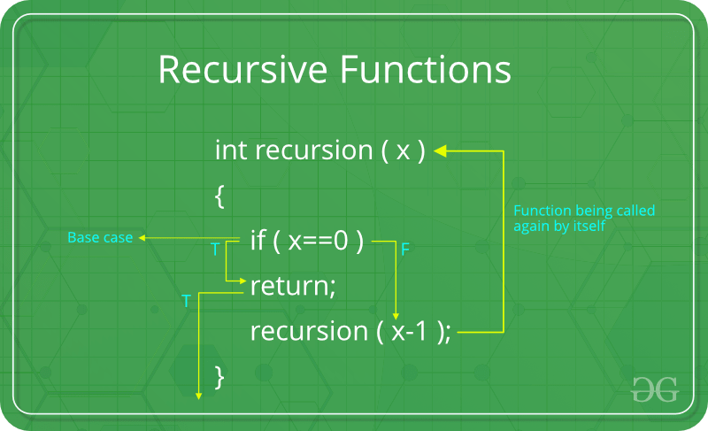
What is recursion?
The process in which a function calls itself directly or indirectly is called recursion and the corresponding function is called as recursive function.
Topic: What is recursion?
Notes:
Recursion is a process where a function calls itself, either directly or indirectly. A function that follows this pattern is called a recursive function.
How Recursion Works
A recursive function solves a problem by breaking it into smaller subproblems.
Each recursive call reduces the problem size until a base case is reached.
Example Code
The function calls itself with a smaller value (x - 1).
The base case (x == 0) stops recursion, preventing infinite calls.
Recursion is useful for problems with self-repeating structures like factorials, Fibonacci sequences, and tree traversals.

Slide 35
Types of Recursion
Recursion are mainly of two types
Direct Recursion
Indirect Recursion
Tail Recursion
Head Recursion
Tree Recursion
Nested Recursion
Topic: Recursion Types
Notes:
Recursion is classified into two main types based on how a function calls itself.
Direct Recursion – A function calls itself directly. It can be further divided into:
Tail Recursion → Recursive call is the last operation in the function.
Head Recursion → Recursive call happens before any processing.
Tree Recursion → A function makes multiple recursive calls within one execution.
Nested Recursion → A function calls itself inside another recursive call.
Indirect Recursion – A function calls another function, which eventually calls the first function back.

Slide 36
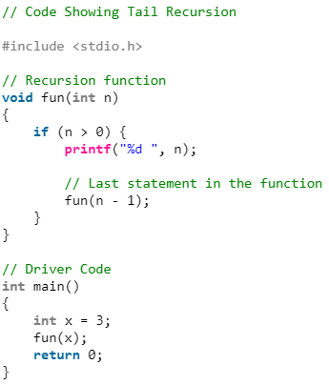

Direct Recursion: Tail Recursion
If a recursive function calling itself and that recursive call is the last statement in the function then it’s known as Tail Recursion. After that call the recursive function performs nothing.
What is the output of this code fragment?
Can you draw a tracing tree showing how the calls are made and how the outputs are produced?
What is the time and space complexity of this code fragment (tail recursion)?
Topic: Tail Recursion
Notes:
Tail recursion occurs when the recursive call is the last operation in the function. After the call, the function does nothing else.
How it Works:
The function prints n and then calls itself with n - 1.
The recursive call is the last operation, meaning no further computation occurs after returning.
Code Execution:
If x = 3, the output is: 3 2 1.
The function keeps calling itself until n reaches 0, at which point it stops.
Time & Space Complexity:
Time Complexity: O(n) → The function runs n times before stopping.
Space Complexity: O(n) → due to function calls stored in the call stack.

Slide 37
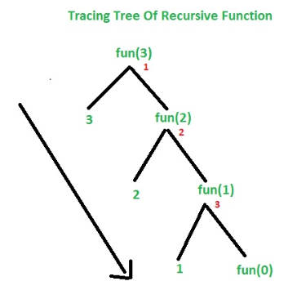
Direct Recursion: Tail Recursion (Contd.)
Can you draw a tracing tree showing how the calls are made and how the outputs are produced?
Topic: Tail Recursion
Notes:
The tracing tree shows how recursive calls are made and how outputs are produced.
Understanding the Code Execution
The function fun(n) prints n first and then calls itself with n-1.
The recursion continues until n = 0, at which point it stops.
Step-by-Step Execution for fun(3)
Call fun(3): Prints 3, then calls fun(2).
Call fun(2): Prints 2, then calls fun(1).
Call fun(1): Prints 1, then calls fun(0).
Call fun(0): Stops, as base case is reached.
Tail recursion does not require storing previous calls, making it more memory efficient. The function executes in O(n) time and can be optimized into an iterative approach.

Slide 38
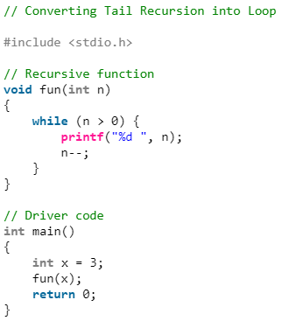
Direct Recursion: Tail Recursion (Contd.)
What is the time and space complexity of this code fragment (tail recursion)?
Can we rewrite this code fragment to have better space complexity?
What is the space complexity now?
Home Work ☺
Topic: Tail Recursion
Notes:
Time and Space Complexity of Tail Recursion
Time Complexity: O(n), since n calls are made.
Space Complexity: O(n), due to function calls stored in the call stack.
Optimizing Space Complexity
Since tail recursion does not require storing previous states, it can be converted into an iterative loop to save space.
Iterative Version of Tail Recursion
Instead of recursive calls, we use a while loop to decrement n and print values.
This eliminates stack memory usage, reducing space complexity to O(1).
Key Takeaway
Tail recursion can always be replaced with iteration, improving space efficiency without changing logic.

Slide 39
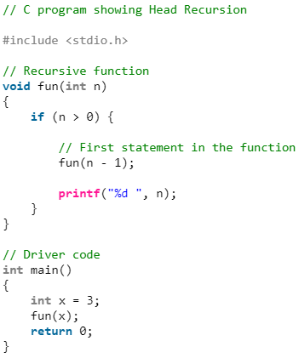


Direct Recursion: Head Recursion
If a recursive function calling itself and that recursive call is the first statement in the function, then it’s known as Head Recursion. There’s no statement, no operation before the call.
What is the output of this code fragment?
Can you draw a tracing tree showing how the calls are made and how the outputs are produced?
What is the time and space complexity of this code fragment (head recursion)?
Topic: Head Recursion
Notes:
In head recursion, the recursive call is the first statement in the function. No operations are performed before the call. The function keeps calling itself until it reaches the base case, and only then does it start executing the remaining statements.
Example Code Explanation
The function fun(n) first calls itself with n-1 before printing n.
This means all recursive calls are made before any output is printed.
As a result, the numbers are printed in ascending order.
Tracing the Output
fun(3) → calls fun(2),
fun(2) → calls fun(1),
fun(1) → calls fun(0), which stops recursion.
Now, the values are printed in reverse order of return: 1, 2, 3.
Time & Space Complexity
Time Complexity: O(n)O(n), as the function is called n times.
Space Complexity: O(n)O(n), because each call is stored in the call stack until all calls return.
Key Takeaway Unlike tail recursion, head recursion builds up a call stack before execution. This leads to higher memory usage but is useful in problems where operations must be done after recursion returns.

Slide 40
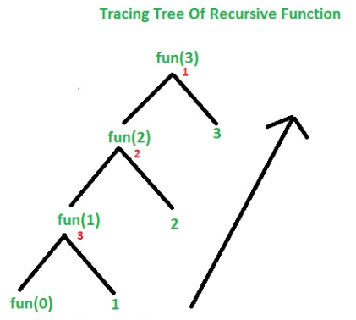
Direct Recursion: Head Recursion (Contd.)
Can you draw a tracing tree showing how the calls are made and how the outputs are produced?
Topic: Head Recursion
Notes:
The formalization of the notion of an algorithm led to great breakthroughs in the
foundations of mathematics in the 1930s.
Head recursion means the recursive call happens first before any operation is performed. This means the function keeps calling itself until it reaches the base case, then starts returning.
Tracing the Function Calls
fun(3) calls fun(2), waiting for it to finish.
fun(2) calls fun(1), waiting for it to finish.
fun(1) calls fun(0), waiting for it to finish.
fun(0) hits the base case and does nothing.
Now, the function starts returning and prints numbers in ascending order: 1, 2, 3.
Why does this happen?
Since the printf("%d", n) is after the recursive call, all function calls are stacked first, and then they execute in reverse order when returning.
Key Takeaway
Tail recursion (previous slide) prints immediately and works in descending order.
Head recursion (this slide) delays printing and works in ascending order.

Slide 41
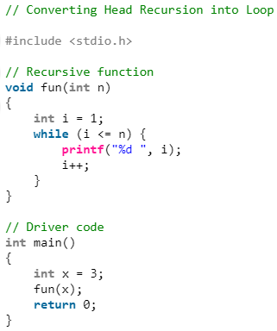
Direct Recursion: Head Recursion (Contd.)
What is the time and space complexity of this code fragment (head recursion)?
Can we rewrite this code fragment to have better space complexity?
What is the space complexity now?
Home Work ☺
Topic: Head Recursion
Notes:
Original Head Recursion Code:
The function calls itself first and executes the printf statement when returning.
This leads to O(n) space complexity since all calls are stored in the stack before execution.
Can we optimize this?
Yes! Instead of recursion, we can use an iterative approach with a loop.
The loop version does not store recursive calls, so it reduces space complexity to O(1).
Rewritten Code (Loop Version)
Instead of calling itself recursively, it uses a loop (while loop).
It directly prints numbers from 1 to n in order.
Key Takeaways
Head recursion requires stack space (O(n)), while iteration does not (O(1)).
Iterative versions are usually more memory-efficient than recursion.
Looping eliminates stack overhead, making the function run with better space complexity.

Slide 42
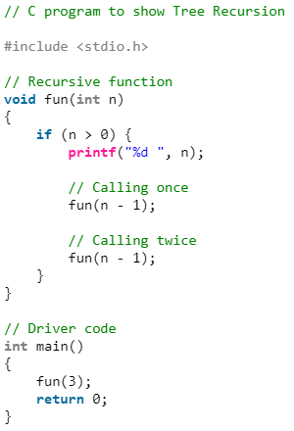


Direct Recursion: Tree Recursion
If a recursive function calling itself for one time then it’s known as Linear Recursion. Otherwise if a recursive function calling itself for more than one time then it’s known as Tree Recursion.
What is the output of this code fragment?
Can you draw a tracing tree showing how the calls are made and how the outputs are produced?
What is the time and space complexity of this code fragment (tree recursion)?
Topic: Tree Recursion
Notes:
Understanding Tree Recursion
A function is tree recursive when it calls itself more than once.
If it only calls itself once, it’s called linear recursion.
Execution Flow:
The function prints n before making two recursive calls.
Each call further makes two more calls, creating a tree-like structure.
This results in an exponential number of calls.
For fun(3), the output is: 3 2 1 1 2 1 1
This follows a tree-like expansion where each call spawns two new recursive calls.
Time & Space Complexity
Time Complexity: O(2ⁿ)
The number of function calls doubles at each level.
Space Complexity: O(n)
The maximum depth of recursion determines the space usage in the call stack.

Slide 43
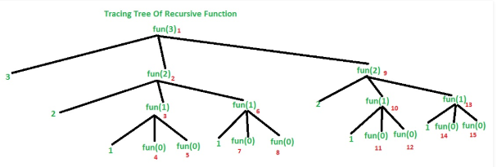
Direct Recursion: Tree Recursion (Contd.)
Can you draw a tracing tree showing how the calls are made and how the outputs are produced?
Topic: Tree Recursion
Notes:
Recursive Calls Breakdown
Starting with fun(3), the function:
Prints 3
Calls fun(2)
Prints 2
Calls fun(1)
Prints 1
Calls fun(0) (Base case reached, stops)
Calls fun(0) (Base case reached, stops)
Calls fun(1)
Prints 1
Calls fun(0) (Base case reached, stops)
Calls fun(0) (Base case reached, stops)
Calls fun(2)
Repeats the same recursive steps.
Each function call branches into two more calls, leading to O(2ⁿ) growth.

Slide 44
Direct Recursion: Tree Recursion (Contd.)
What is the time and space complexity of this code fragment (tree recursion)?
2⁰
2¹
2²
2³
T(n)=2⁰+2¹ +…+ 2^{n} =2^{n+1} – 1≤2^{n+1}=2x2^{n}= O(2^{n})
Can you explain why space complexity is O(n)?
Home Work ☺
Topic: Tree Recursion
Notes:
Space complexity refers to the maximum amount of memory required at any given time during execution.
For tree recursion, space is mainly used by:
Function call stack - Every recursive call consumes stack memory.
Active function calls - The depth of the recursion determines the maximum memory usage.
Why is Space Complexity O(n) and not O(2ⁿ)?
Key observation: Recursion call depth
The space complexity is determined by the deepest path in the recursion tree.
The deepest path is from the root (fun(n)) down to a base case (fun(0)).
Since we decrease n by 1 with each recursive call, the maximum depth of recursion is n.
Even though we have O(2ⁿ) calls, they do not exist at the same time.
Calls at one level finish before moving to the next.
The stack only holds O(n) active calls at a time.
Final Complexity
Time Complexity: O(2ⁿ) → Since each function call creates two recursive calls.
Space Complexity: O(n) → Since the maximum depth of recursion is n, meaning at most n calls are stored in memory at any given time

Slide 45

Direct Recursion: Nested Recursion
In this recursion, a recursive function will pass the parameter as a recursive call. That means “recursion inside recursion”.
What is the output of this code fragment?
Can you draw a tracing tree showing how the calls are made and how the outputs are produced?
What is the time and space complexity of this code fragment (nested recursion)?
Home Work ☺
Topic: Nested Recursion
Notes:
Understanding Nested Recursion
Nested recursion is a type of recursion where the argument of a recursive function is itself a recursive call. This means that the function makes a recursive call within another recursive call, leading to a complex evaluation structure.
In the given function:
If n > 100, the function terminates and returns n - 10.
Otherwise, the function calls itself recursively, first computing fun(n + 11), then using that result as an argument for another recursive call.
Step-by-Step Execution
For fun(95), let's analyze the calls:
fun(95) calls fun(fun(106))
fun(106) > 100, so it returns 96
fun(95) then becomes fun(96), which calls fun(fun(107))
fun(107) > 100, so it returns 97
fun(96) then becomes fun(97), which calls fun(fun(108))
This process continues until we reach fun(100), which calls fun(111), returning 101
Then, the recursion begins to unwind, resolving all nested calls.
Eventually, fun(95) resolves to 91.

Slide 46
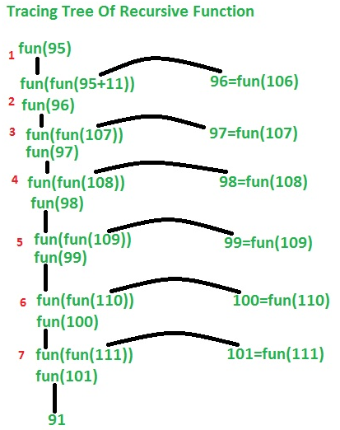
Direct Recursion: Nested Recursion (Contd.)
Can you draw a tracing tree showing how the calls are made and how the outputs are produced?
Topic: Nested Recursion
Notes:
Step-by-Step Call Tracing for fun(95)
Initial Call:
fun(95) calls fun(fun(106))
fun(106) > 100, so it returns 96
Now, fun(95) = fun(96)
Recursive Expansion:
fun(96) calls fun(fun(107))
fun(107) > 100, so it returns 97
Now, fun(96) = fun(97)
Continuation:
fun(97) = fun(98)
fun(98) = fun(99)
fun(99) = fun(100)
fun(100) = fun(101)
fun(101) > 100, so it returns 91
Returning Values:
fun(100) = 91
fun(99) = 91
fun(98) = 91
fun(97) = 91
fun(96) = 91
fun(95) = 91
Thus, fun(95) = 91, which is the final output.

Slide 47
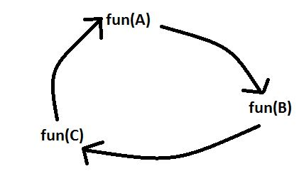
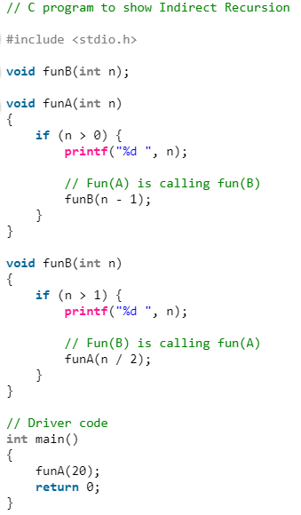

Indirect Recursion
In this recursion, there may be more than one functions and they are calling one another in a circular manner.
What is the output of this code fragment?
From the above diagram fun(A) is calling for fun(B), fun(B) is calling for fun(C) and fun(C) is calling for fun(A) and thus it makes a cycle.
Home Work ☺
Can you draw a tracing tree showing how the calls are made and how the outputs are produced?
Topic: Indirect Recursion
Notes:
Understanding Indirect Recursion
funA(n) prints n and calls funB(n-1).
funB(n) prints n and calls funA(n/2).
This alternates between the two functions, decreasing n in different ways.
Tracing the Execution for funA(20)
funA(20) prints 20 and calls funB(19).
funB(19) prints 19 and calls funA(19/2) = funA(9).
funA(9) prints 9 and calls funB(8).
funB(8) prints 8 and calls funA(8/2) = funA(4).
funA(4) prints 4 and calls funB(3).
funB(3) prints 3 and calls funA(3/2) = funA(1).
funA(1) prints 1 and calls funB(0), which does nothing.

Slide 48
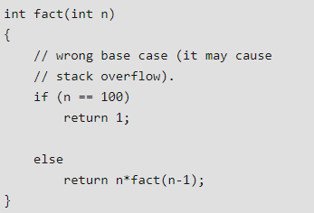
Why Stack Overflow error occurs in recursion?
If the base case is not reached or not defined, then the stack overflow problem may arise.
Can you give an example and explain why there will be a stack overflow?
Why does stack overflow eventually?
Topic: Stack Overflow
Notes:
A Stack Overflow occurs when a recursive function keeps calling itself indefinitely without reaching a termination condition.
Problem in this Code:
The base case is only defined for n == 100, but what if we call fact(5)?
It will recursively call fact(4), then fact(3), and so on, without ever stopping because n will never reach 100.
Example of Failure
fact(5);
Calls fact(4)
Calls fact(3)
Calls fact(2)
Calls fact(1)
Calls fact(0)
Calls fact(-1), fact(-2), and keeps going forever.
Why does Stack Overflow happen?
Each recursive call is stored in the call stack.
Since the function never stops, new calls keep stacking up.
At some point, the stack memory is exhausted, causing a Stack Overflow error.
Key Takeaway
Always define a reachable base case to terminate recursion.
Ensure input values eventually hit the base case to prevent infinite function calls.

Slide 49
Summary
Algorithms are step-by-step procedures for solving problems efficiently.
Efficiency analysis is done using Big-O notation, focusing on time and space complexity.
Best-case, worst-case, and average-case complexities help compare algorithm performance.
Choosing the right algorithm depends on problem constraints, required efficiency, and available resources.
Recursion involves a function calling itself, with different types like tail, head, tree, nested, and indirect recursion.

